Slide 1

Commitment
Notes on Behavioural Economics
Jason Collins

Slide 2


Slide 3
Depress the value of the bad course of action
Increase the value of the optimal course of action
Force the agent to maintain the optimal course of action

Slide 4
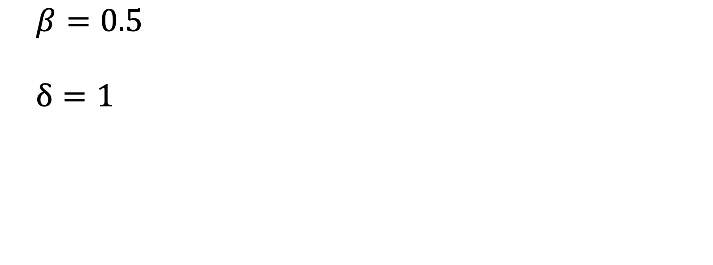
$$β=0.5$$
$$δ=1$$

Slide 5
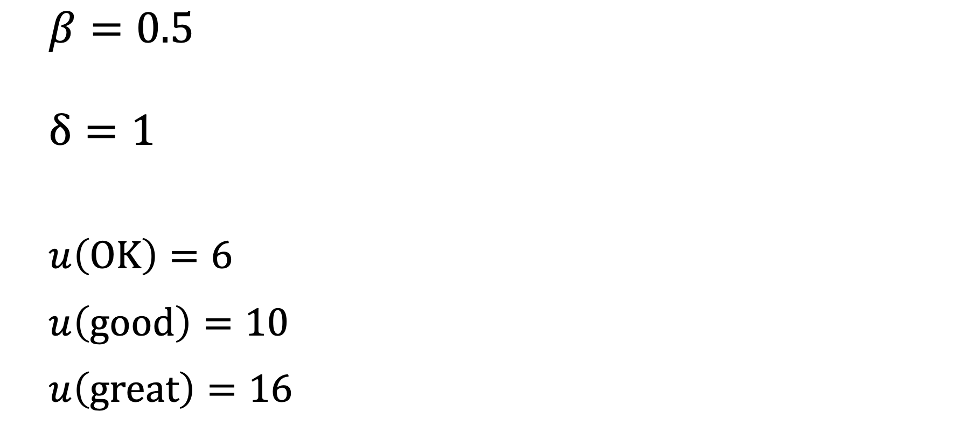
$$β=0.5$$
$$δ=1$$
$$u\left(OK\right)=6$$
$$u\left(good\right)=10$$
$$u\left(great\right)=16$$

Slide 6
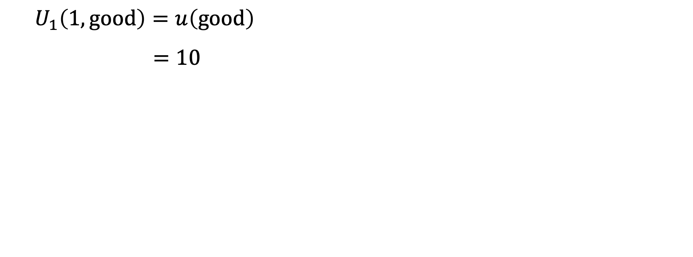
$$U_{1}\left(1,good\right)=u\left(good\right)$$
$$=10$$

Slide 7
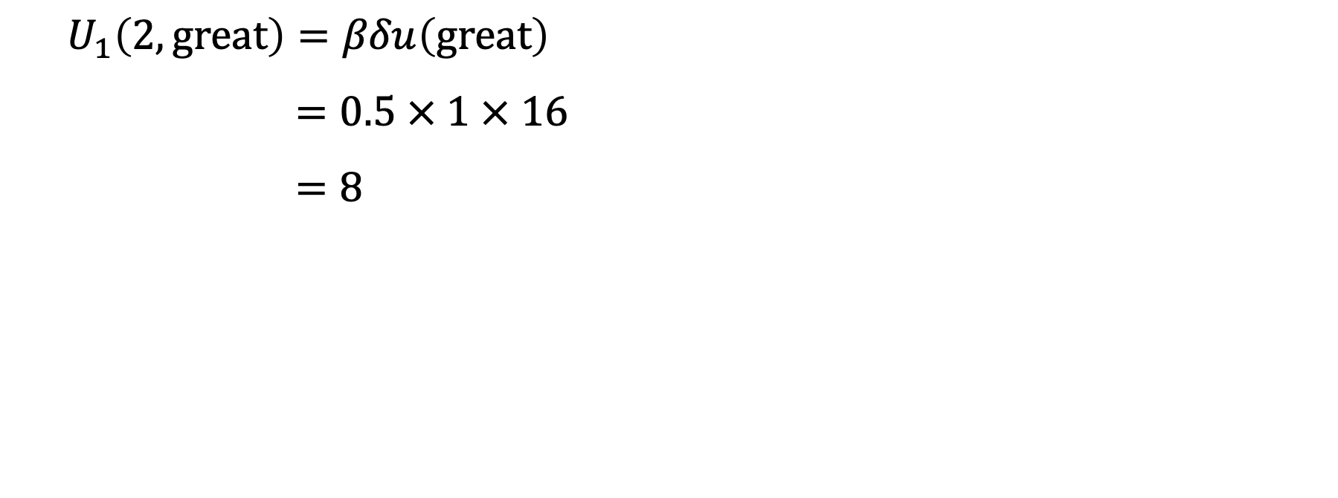
$$U_{1}\left(2, great\right)=βδu\left(great\right)$$
$$=0.5 × 1 × 16$$
$$=8$$

Slide 8
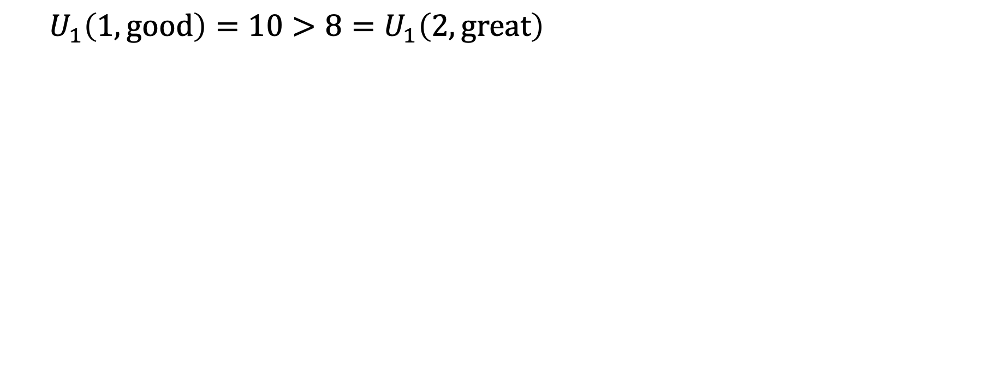
$$U_{1}\left(1,good\right)=10>8=U_{1}\left(2,great\right)$$

Slide 9
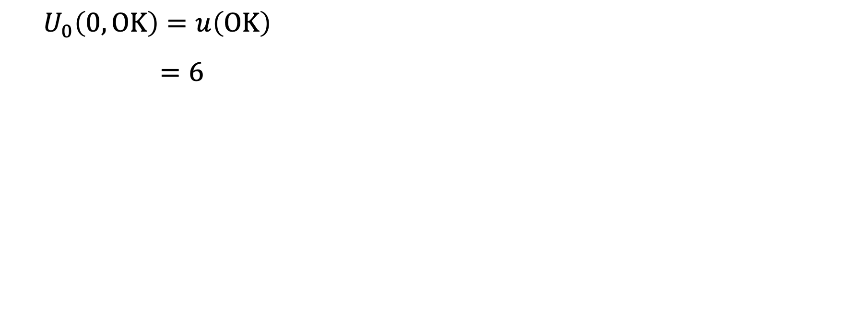
$$U_{0}\left(0,OK\right)=u\left(OK\right)$$
$$=6$$

Slide 10
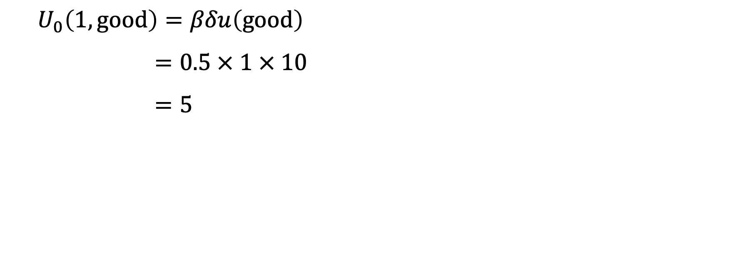
$$U_{0}\left(1, good\right)=βδu\left(good\right)$$
$$=0.5 × 1 × 10$$
$$=5$$

Slide 11
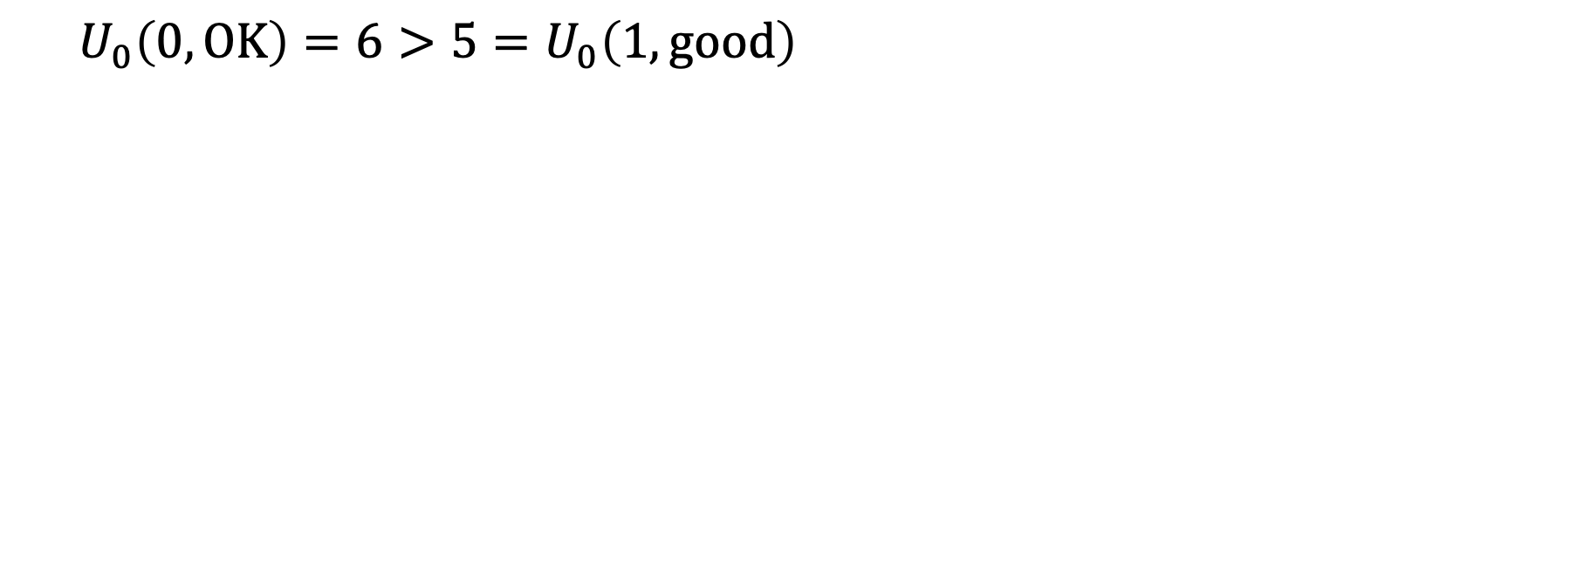
$$U_{0}\left(0,OK\right)=6>5=U_{0}\left(1,good\right)$$

Slide 12
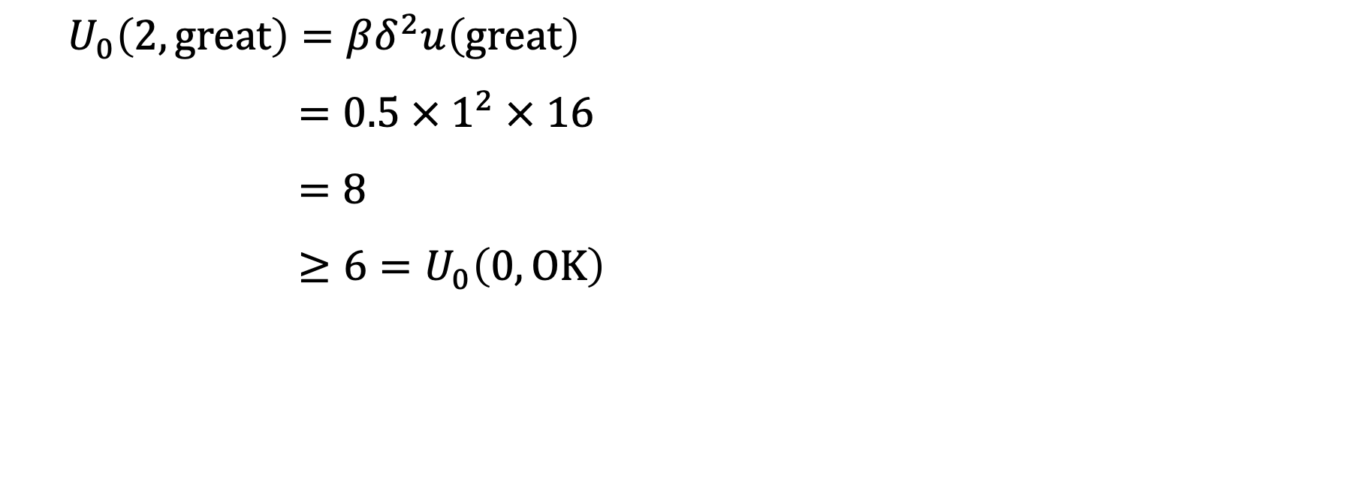
$$U_{0}\left(2, great\right)=βδ^{2}u\left(great\right)$$
$$=0.5 ×{ 1}^{2} × 16$$
$$=8$$
$$≥6=U_{0}\left(0,OK\right)$$

Slide 13
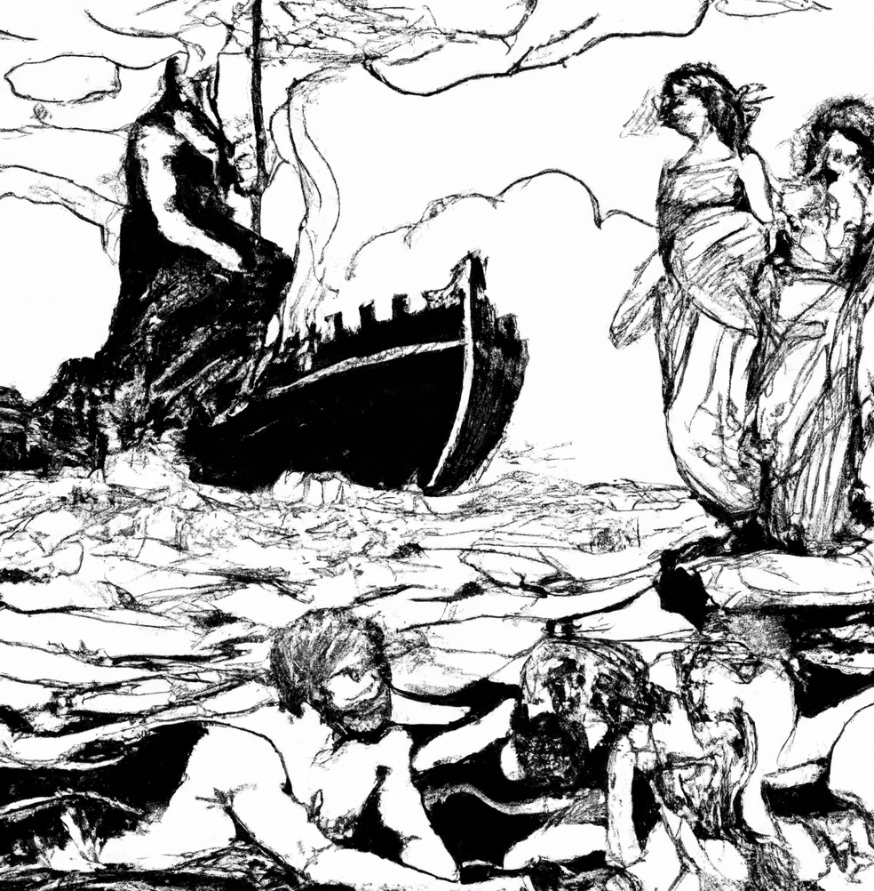

Slide 14
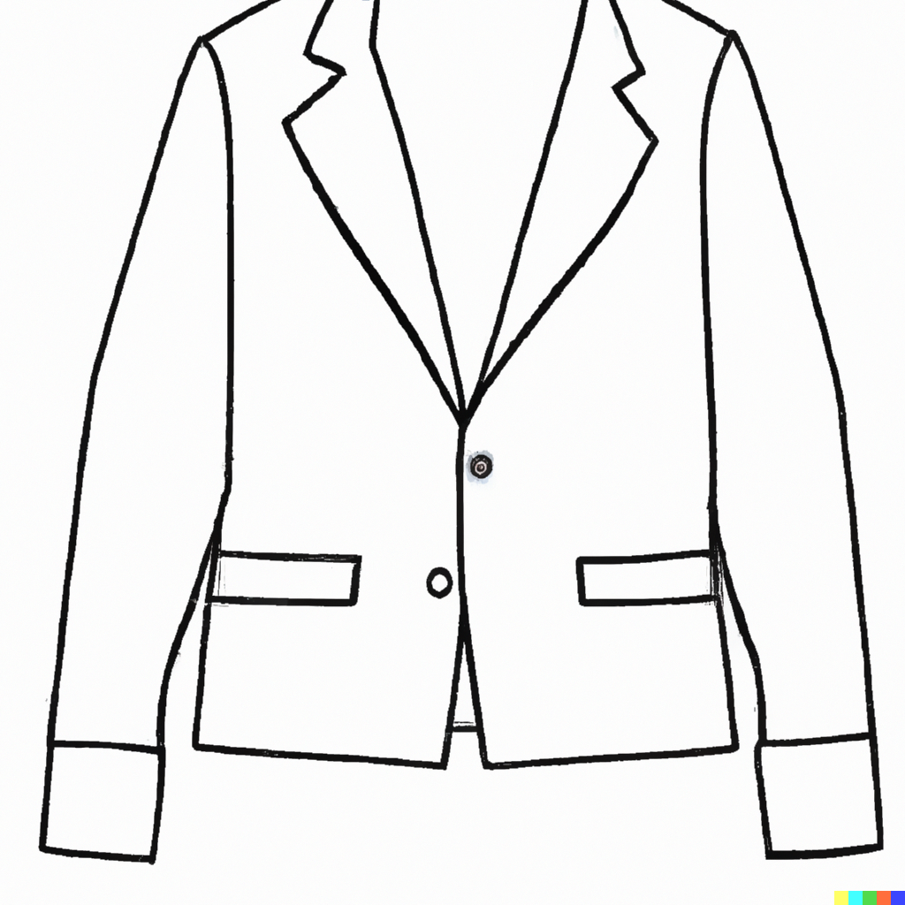
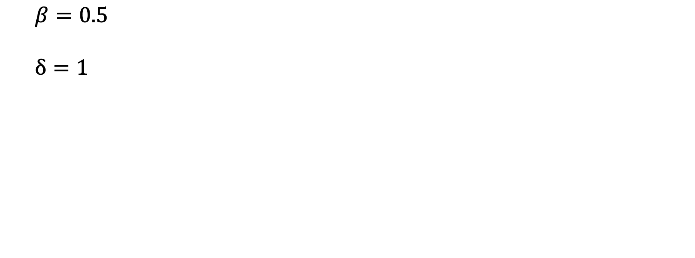
$$β=0.5$$
$$δ=1$$

Slide 15
 | t = 0 | t = 1 | t = 2
Save | 0 | 0 | 45
Spend | 10 | 10 | 10

Slide 16
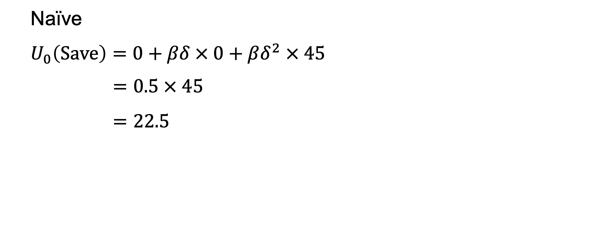
Naïve
$$U_{0}\left(\text{Save}\right)=0+βδ × 0+βδ^{2} × 45$$
$$=0.5 × 45$$
$$=22.5$$

Slide 17
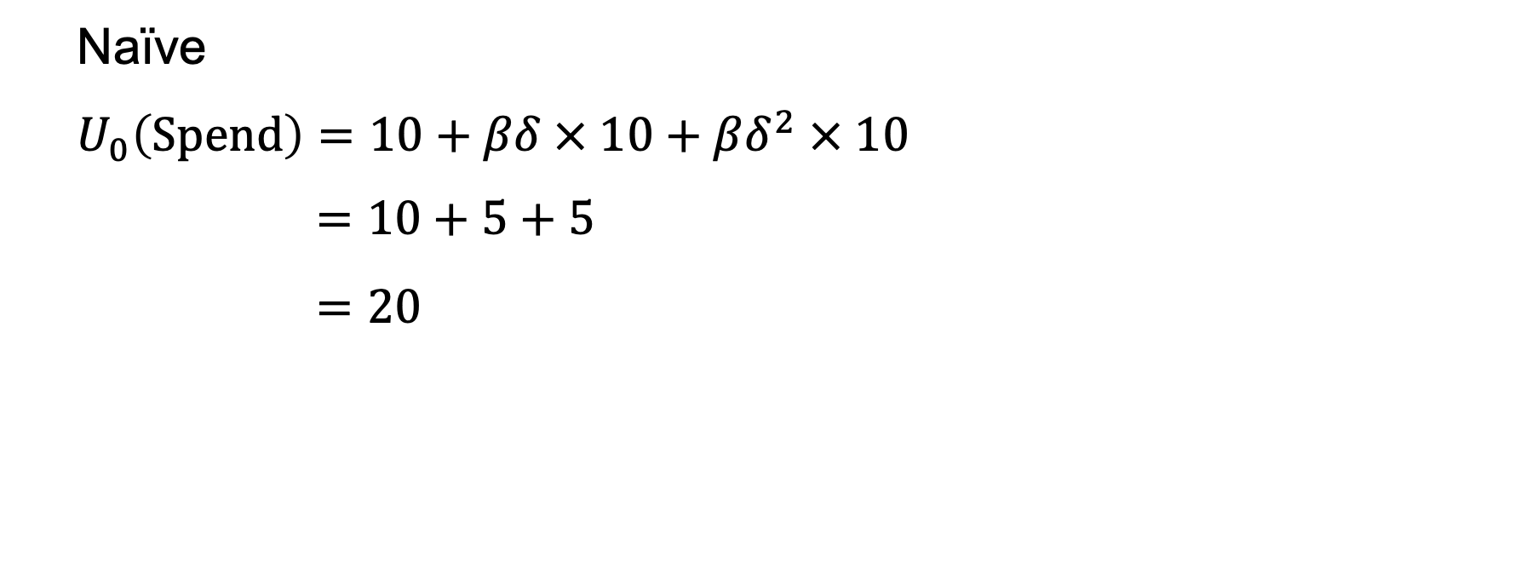
Naïve
$$U_{0}\left(Spend\right)=10+βδ × 10+βδ^{2} × 10$$
$$=10+5+5$$
$$=20$$

Slide 18
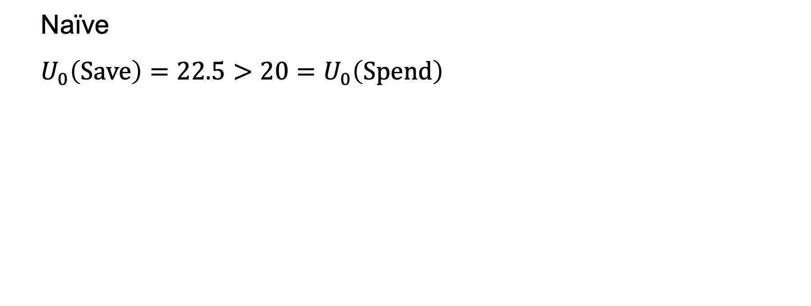
Naïve
$$U_{0}\left(\text{Save}\right)=22.5>20=U_{0}\left(Spend\right)$$

Slide 19
 | t = 1 | t = 2
Save | 0 | 45
Spend | 20 | 10

Slide 20
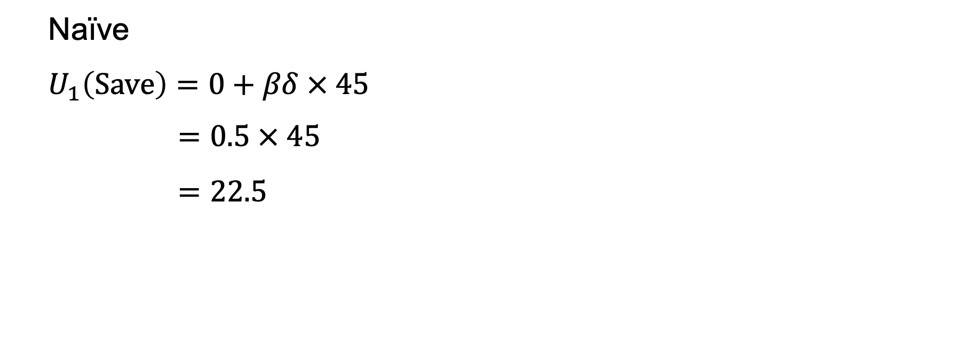
Naïve
$$U_{1}\left(\text{Save}\right)=0+βδ × 45$$
$$=0.5 × 45$$
$$=22.5$$

Slide 21
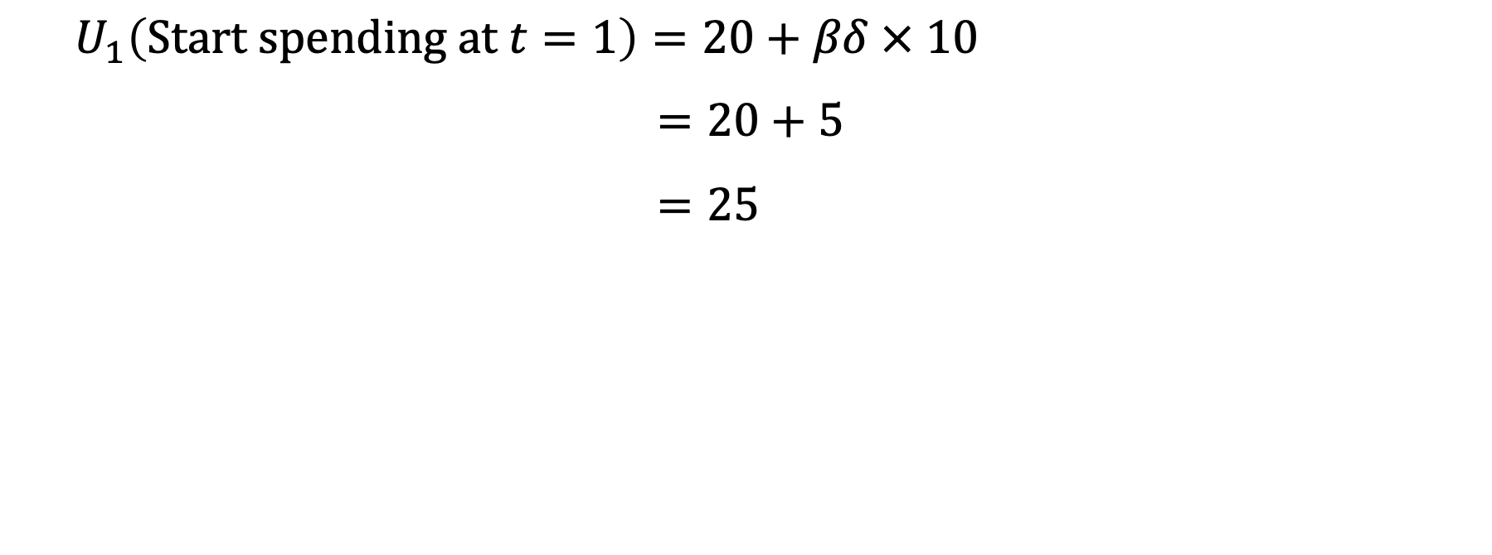
$$U_{1}\left(\text{Start} \text{spending} \text{at} t=1\right)=20+βδ × 10$$
$$=20+5$$
$$=25$$

Slide 22
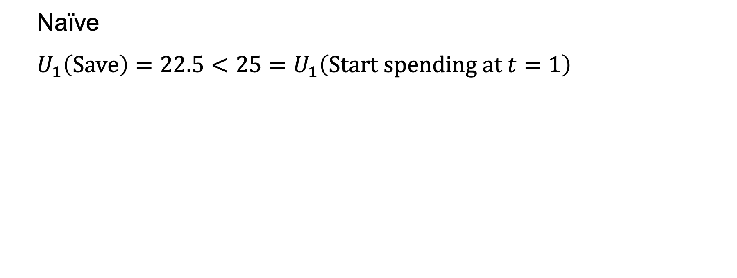
Naïve
$$U_{1}\left(\text{Save}\right)=22.5<25=U_{1}\left(\text{Start} \text{spending} \text{at} t=1\right)$$

Slide 23
 | t = 0 | t = 1 | t = 2
Save | 0 | 0 | 45
Start spending at t=1 | 0 | 20 | 10
Spend | 10 | 10 | 10

Slide 24
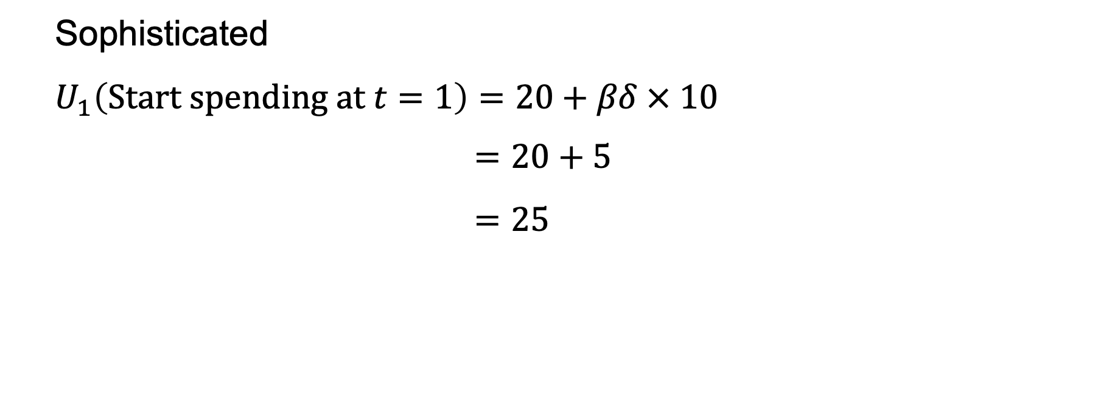
Sophisticated
$$U_{1}\left(\text{Start} \text{spending} \text{at} t=1\right)=20+βδ × 10$$
$$=20+5$$
$$=25$$

Slide 25
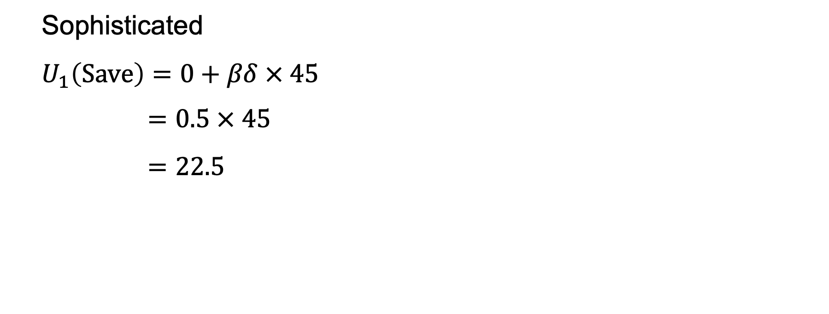
Sophisticated
$$U_{1}\left(\text{Save}\right)=0+βδ × 45$$
$$=0.5 × 45$$
$$=22.5$$

Slide 26
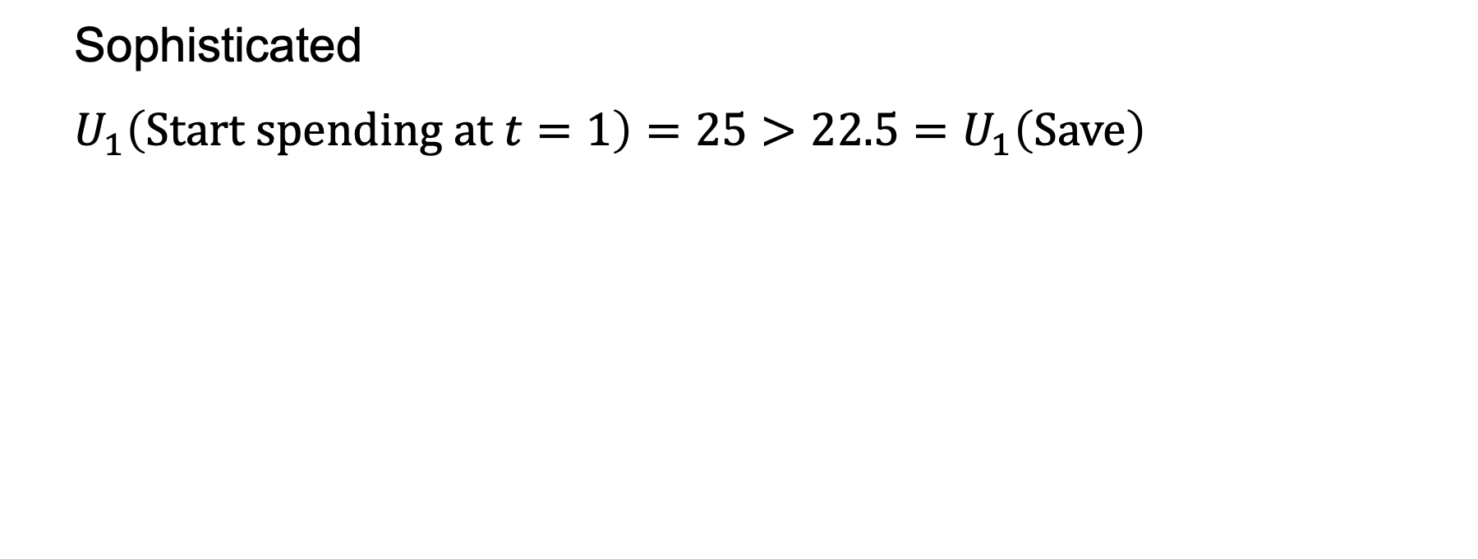
Sophisticated
$$U_{1}\left(\text{Start} \text{spending} \text{at} t=1\right)=25>22.5=U_{1}\left(\text{Save}\right)$$

Slide 27
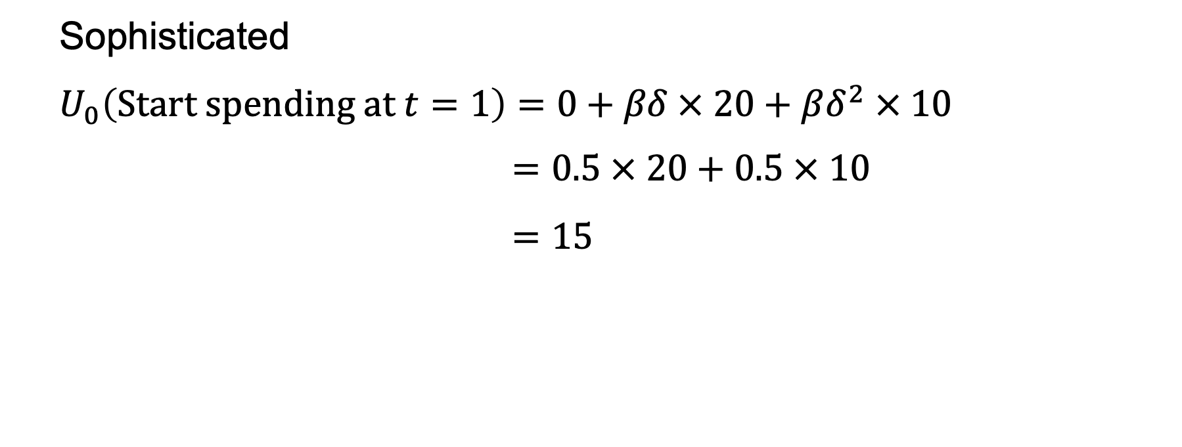
Sophisticated
$$U_{0}\left(\text{Start} \text{spending} \text{at} t=1\right)=0+βδ × 20+βδ^{2} × 10$$
$$=0.5 × 20+0.5 × 10$$
$$=15$$

Slide 28
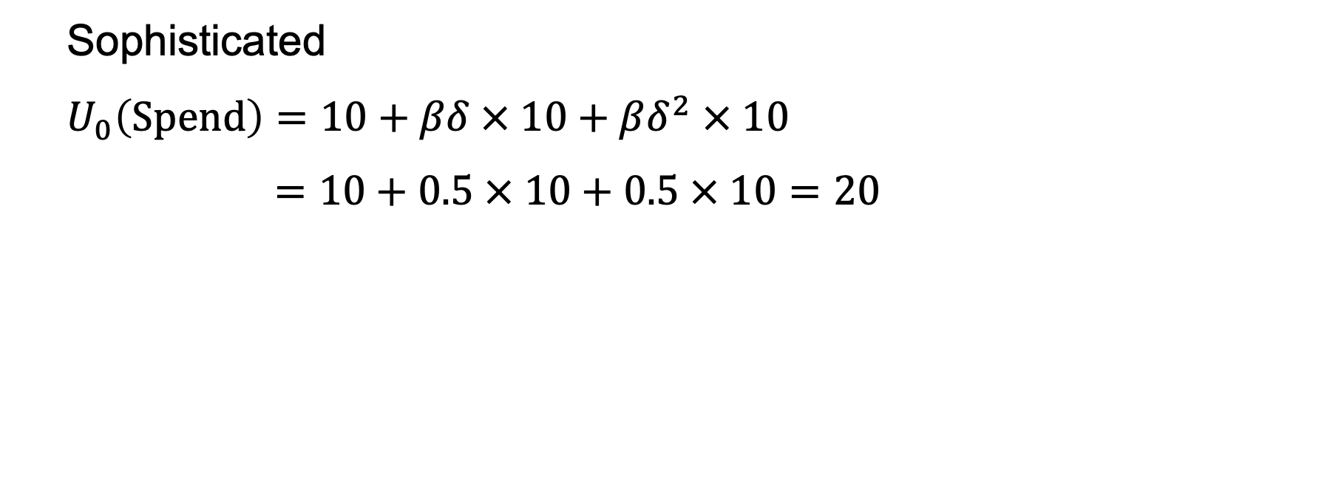
Sophisticated
$$U_{0}\left(\text{Spend}\right)=10+βδ × 10+βδ^{2} × 10$$
$$=10+0.5 × 10+0.5 × 10=20$$

Slide 29
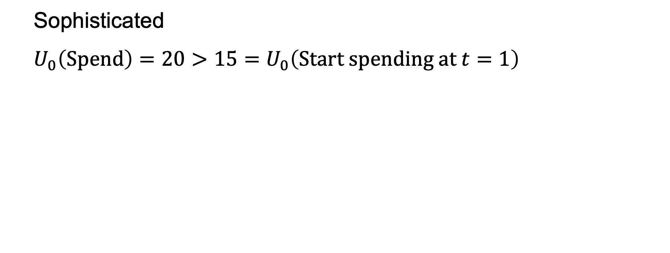
Sophisticated
$$U_{0}\left(\text{Spend}\right)=20>15=U_{0}\left(\text{Start} \text{spending} \text{at} t=1\right)$$

Slide 30
 | t = 0 | t = 1 | t = 2
Save | 0 | 0 | 45
Start spending at t=1 | 0 | 20 | 10
Spend | 10 | 10 | 10
Lay-by | -1 | 0 | 45

Slide 31
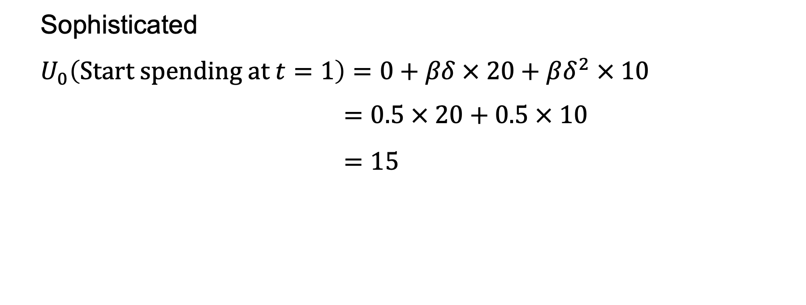
Sophisticated
$$U_{0}\left(\text{Start} \text{spending} \text{at} t=1\right)=0+βδ × 20+βδ^{2} × 10$$
$$=0.5 × 20+0.5 × 10$$
$$=15$$

Slide 32
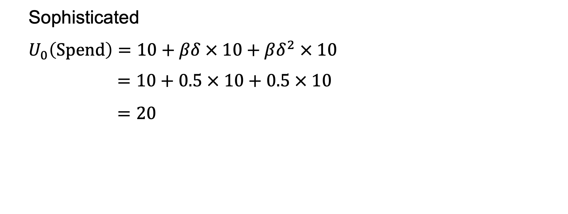
Sophisticated
$$U_{0}\left(\text{Spend}\right)=10+βδ × 10+βδ^{2} × 10$$
$$=10+0.5 × 10+0.5 × 10$$
$$=20$$

Slide 33
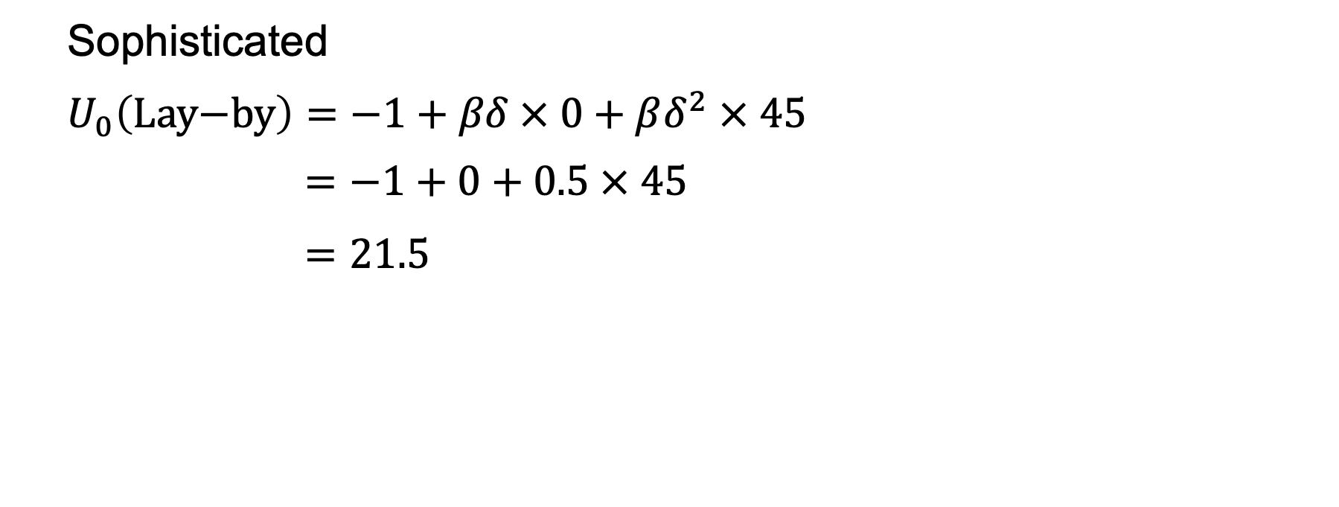
Sophisticated
$$U_{0}\left(\text{Lay}\text{−}\text{by}\right)=−1+βδ × 0+βδ^{2} × 45$$
$$=−1+0+0.5 × 45$$
$$=21.5$$

Slide 34
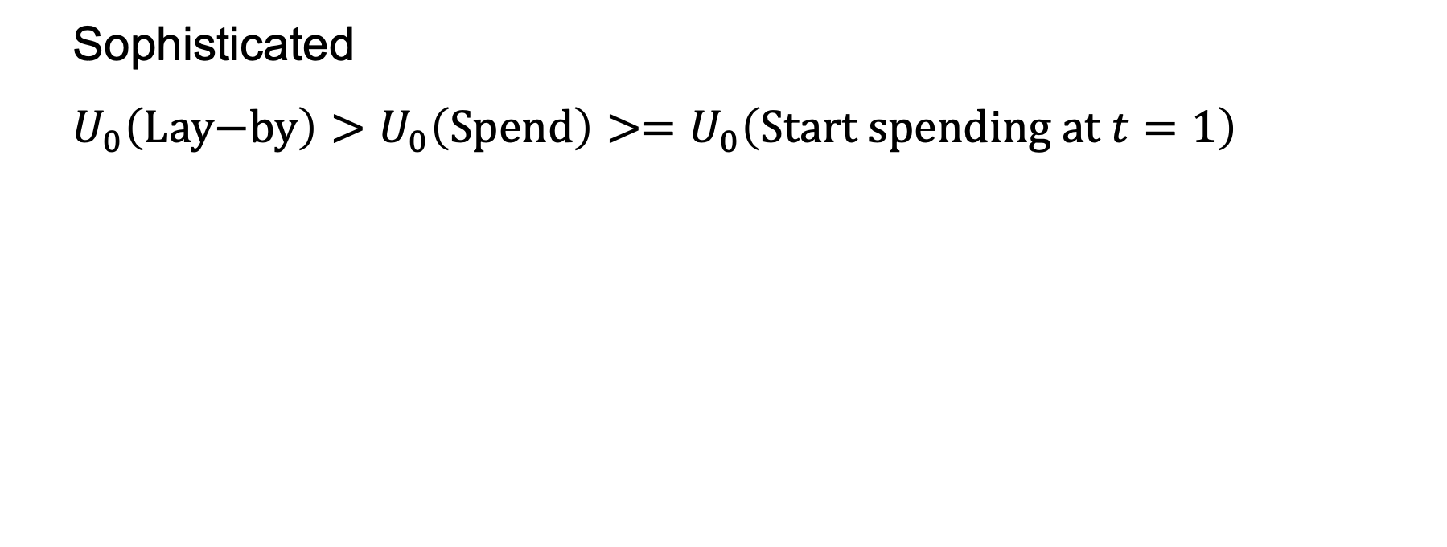
Sophisticated
$$U_{0}\left(\text{Lay}\text{−}\text{by}\right)>U_{0}\left(\text{Spend}\right)>=U_{0}\left(\text{Start} \text{spending} \text{at} t=1\right)$$

Slide 35


Slide 36


Slide 37
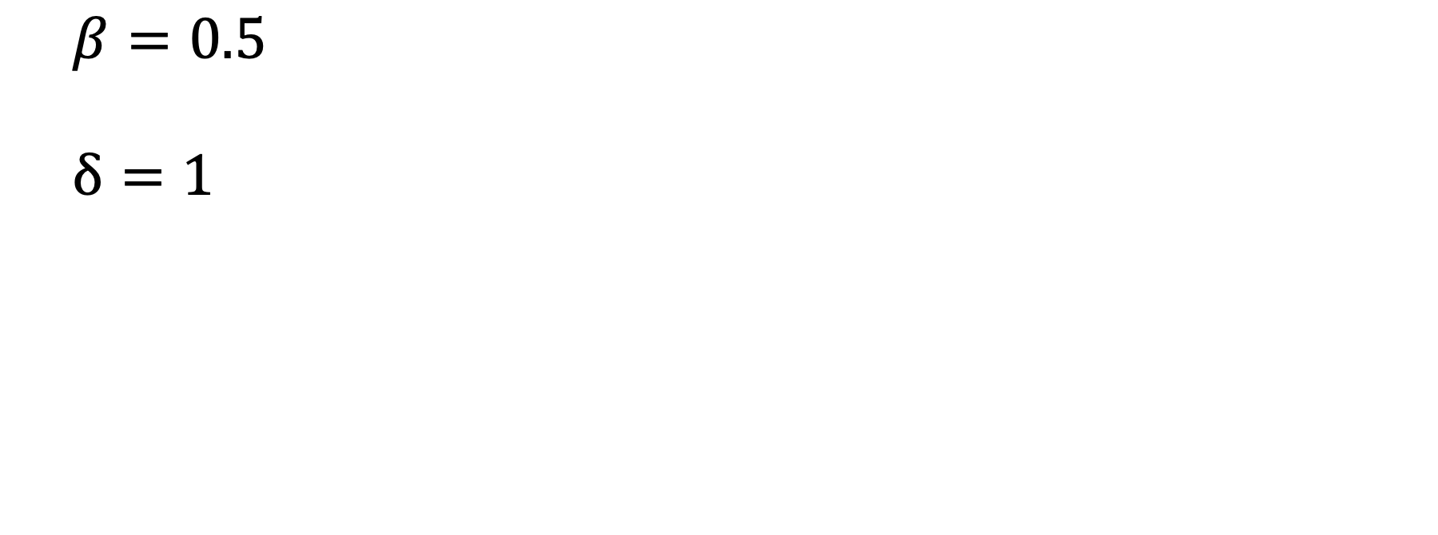
$$β=0.5$$
$$δ=1$$

Slide 38
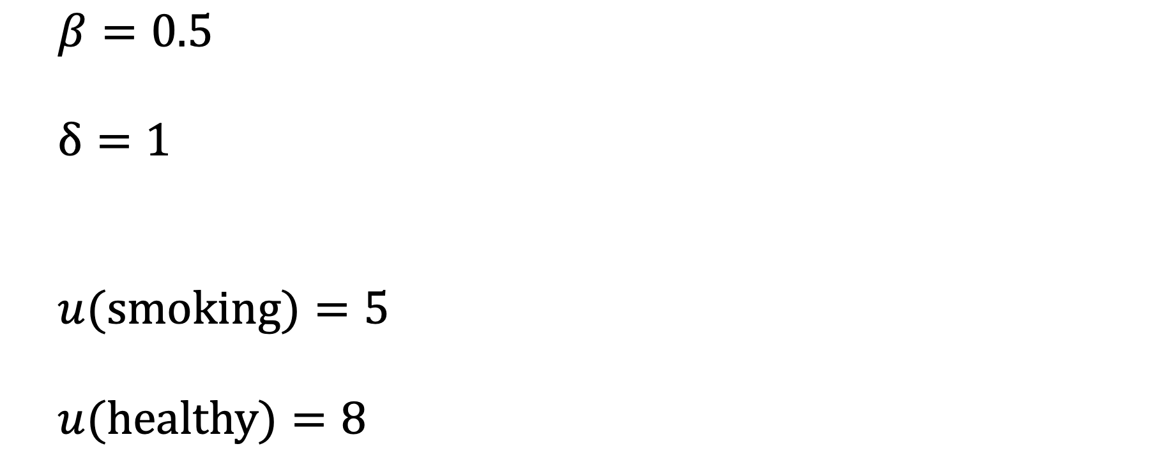
$$β=0.5$$
$$δ=1$$
$$u(smoking)=5$$
$$u(healthy)=8$$

Slide 39
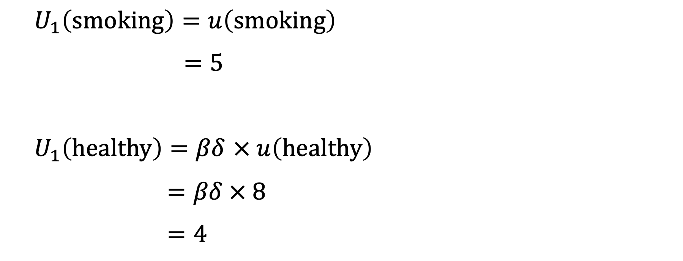
$$U_{1}\left(smoking\right)=u\left(smoking\right)$$
$$=5$$
$U_{1}\left(healthy\right)=βδ$ $× u\left(healthy\right)$
$$=βδ × 8$$
$$=4$$

Slide 40
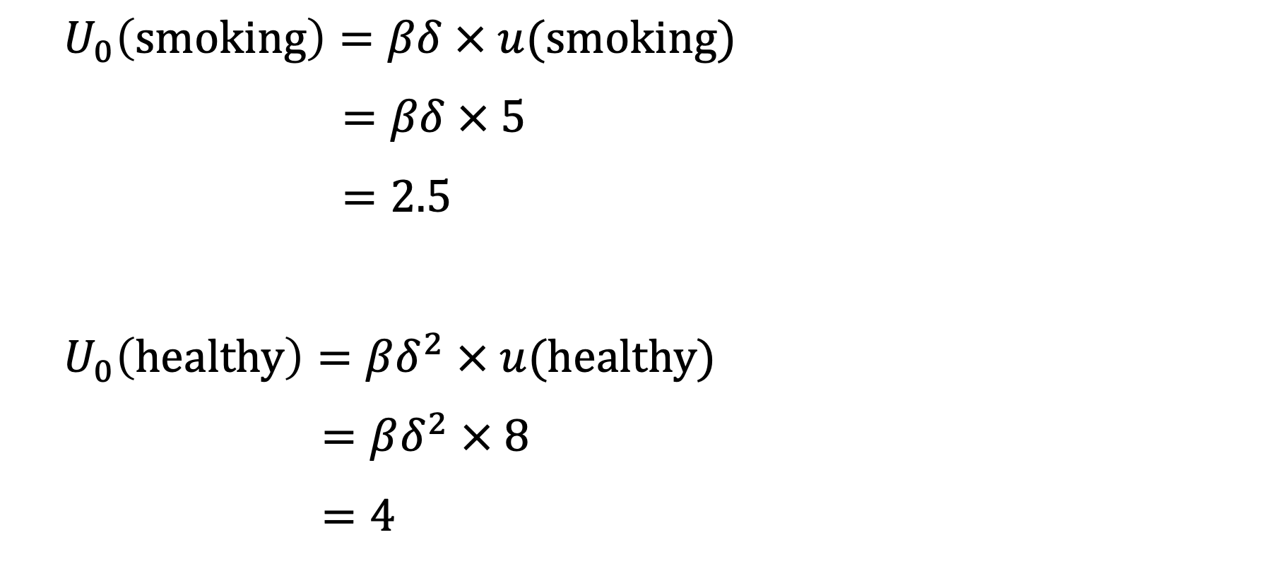
$$U_{0}\left(smoking\right)=βδ × u(smoking)$$
$$=βδ × 5$$
$$=2.5$$
$$U_{0}\left(healthy\right)=βδ^{2} × u(healthy)$$
$$=βδ^{2} × 8$$
$$=4$$

Slide 42
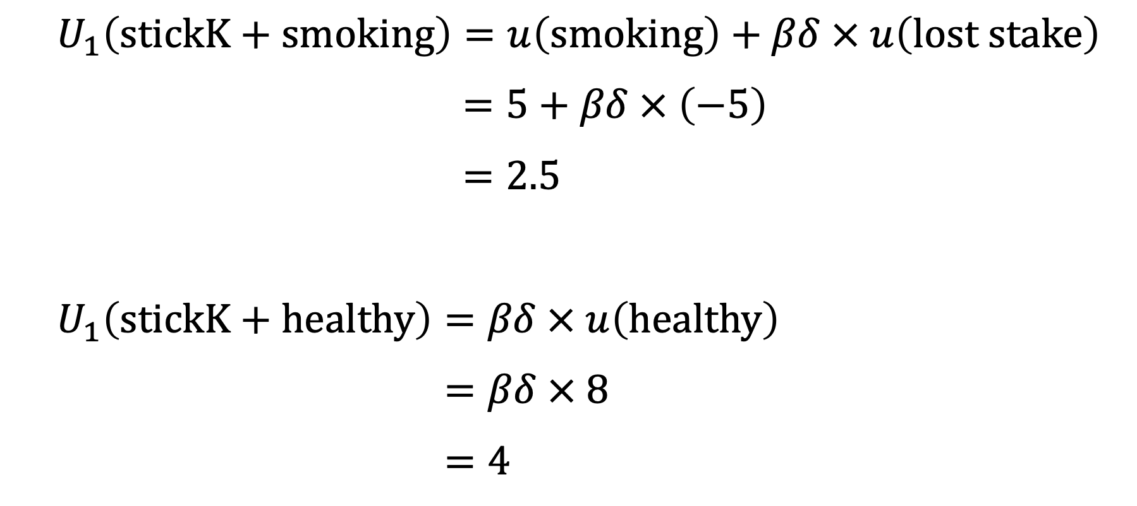
$$U_{1}\left(stickK+smoking\right)=u\left(smoking\right)+βδ × u\left(lost stake\right)$$
$$=5+βδ × \left(−5\right)$$
$$=2.5$$
$$U_{1}\left(stickK+healthy\right)=βδ × u\left(healthy\right)$$
$$=βδ × 8$$
$$=4$$

Slide 43
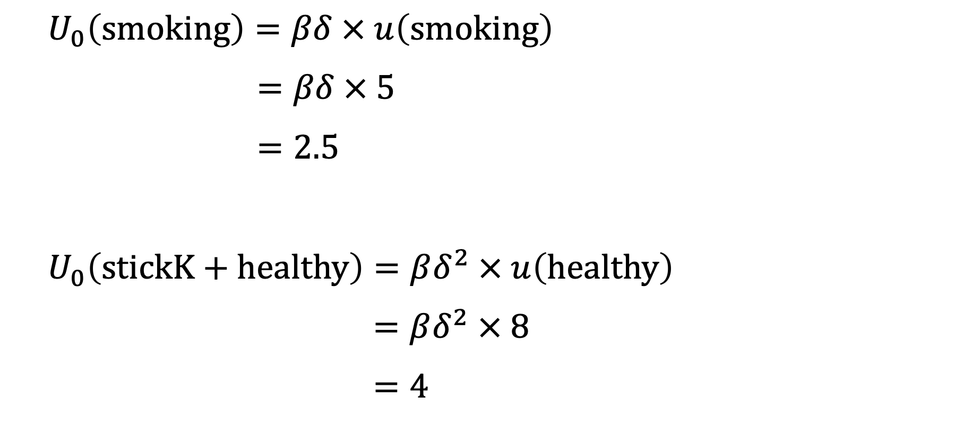
$$U_{0}\left(smoking\right)=βδ × u\left(smoking\right)$$
$$=βδ × 5$$
$$=2.5$$
$$U_{0}\left(stickK+healthy\right)=βδ^{2} × u\left(healthy\right)$$
$$=βδ^{2} × 8$$
$$=4$$

Slide 44
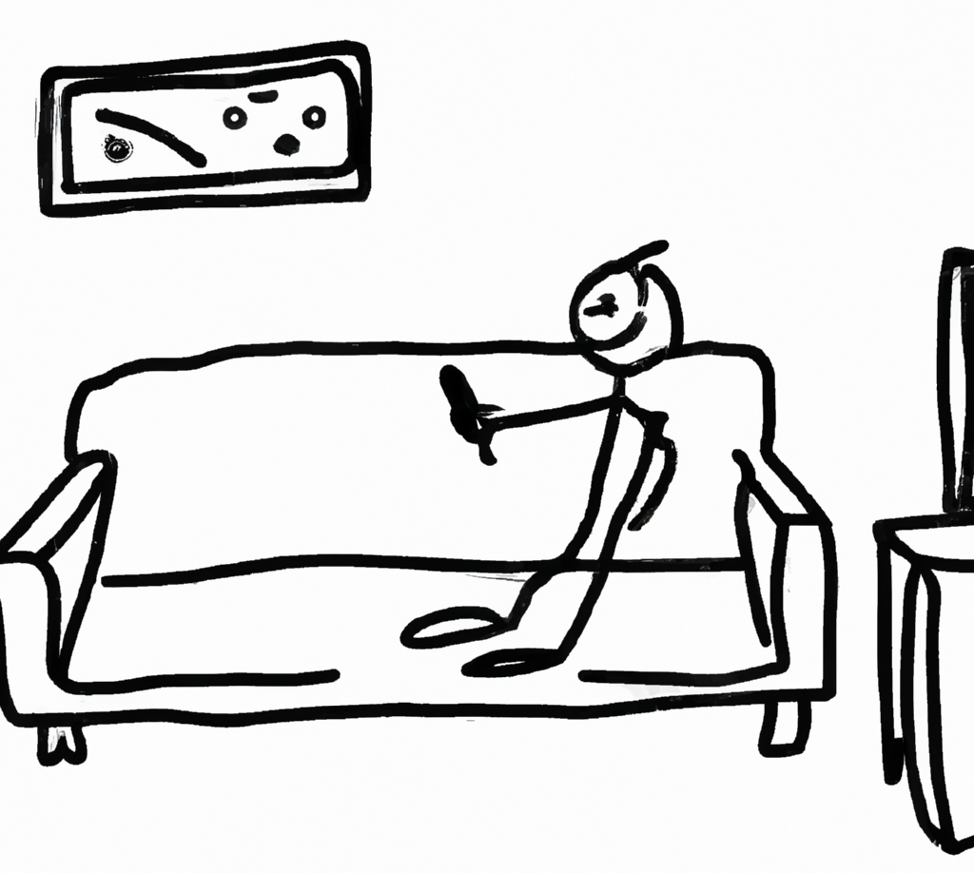

Slide 45
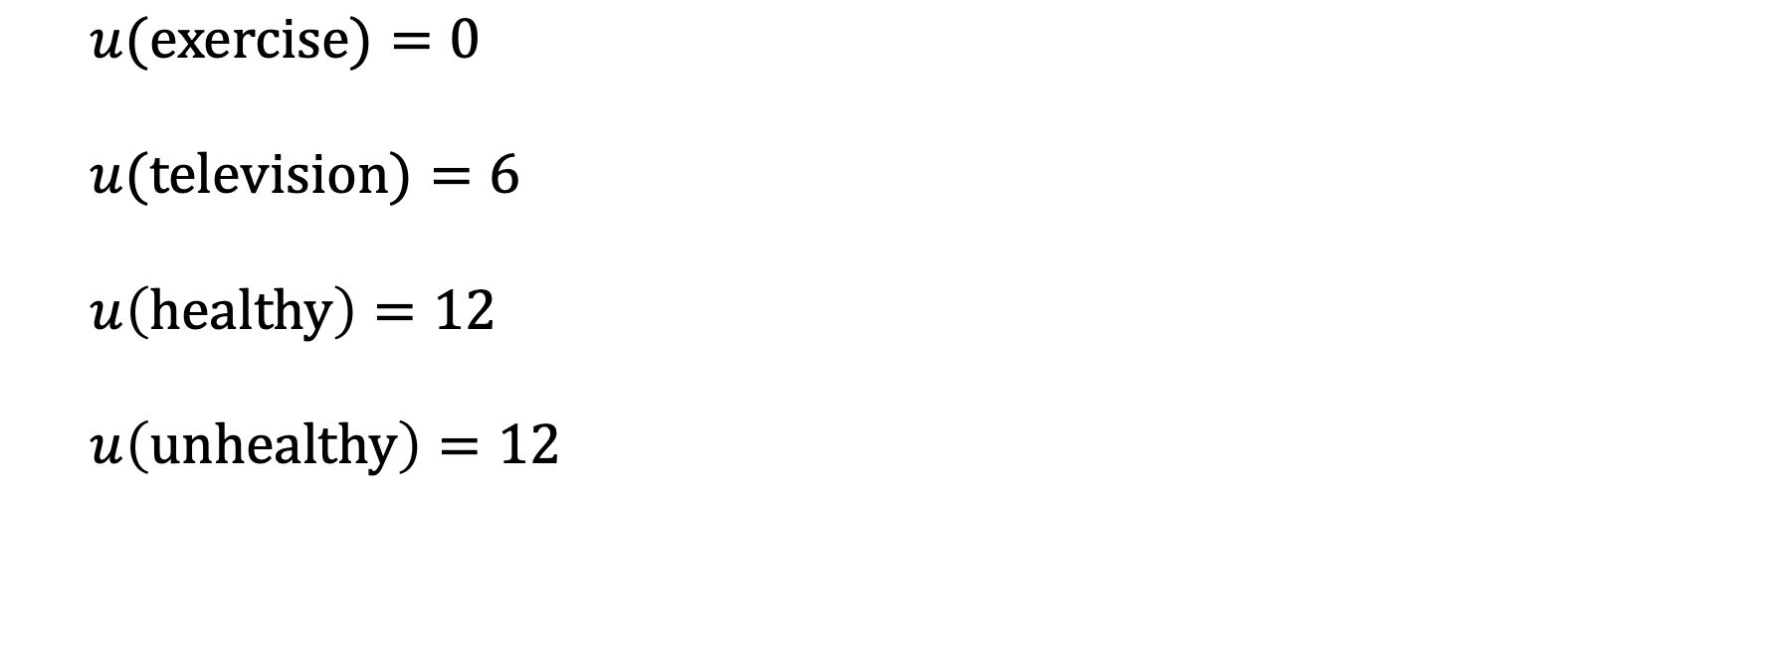
$$u(exercise)=0$$
$$u(television)=6$$
$$u\left(healthy\right)=12$$
$$u\left(unhealthy\right)=12$$

Slide 46
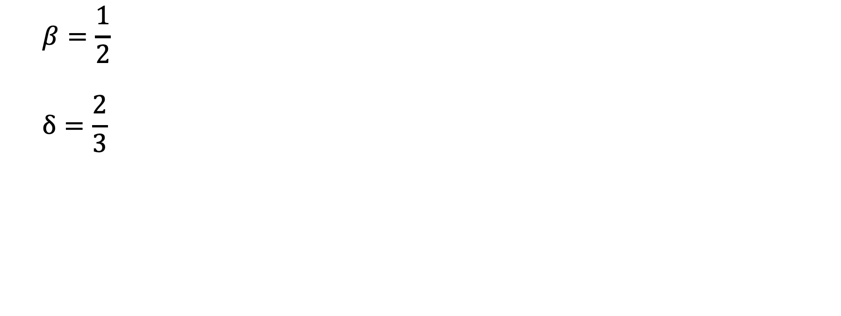
$$β=\frac{1}{2}$$
$$δ=\frac{2}{3}$$

Slide 47
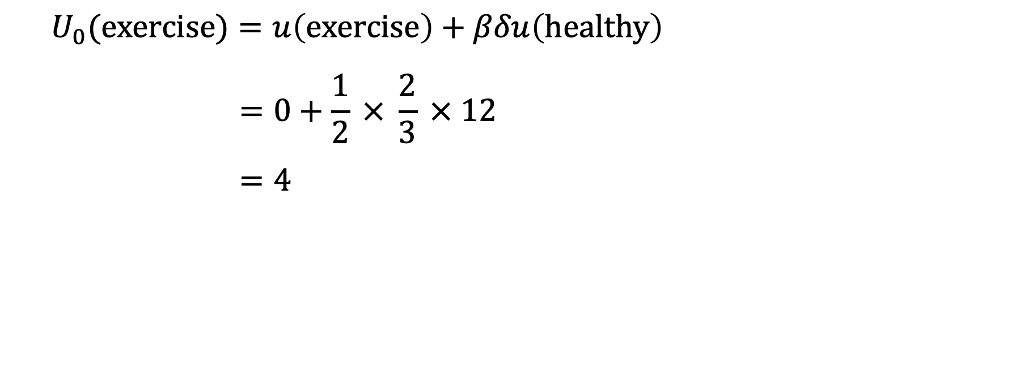
$$U_{0}(exercise)=u\left(exercise\right)+βδu\left(healthy\right)$$
$$=0+\frac{1}{2} × \frac{2}{3} × 12$$
$$=4$$

Slide 48
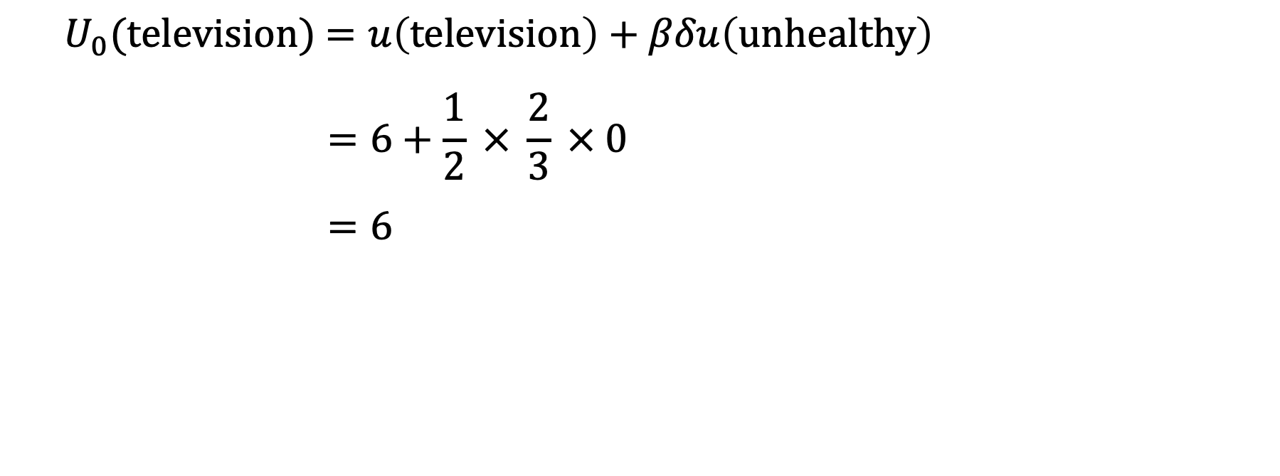
$U_{0}(television)$ $=u\left(television\right)+βδu\left(unhealthy\right)$
$$=6+\frac{1}{2} × \frac{2}{3} × 0$$
$$=6$$

Slide 49
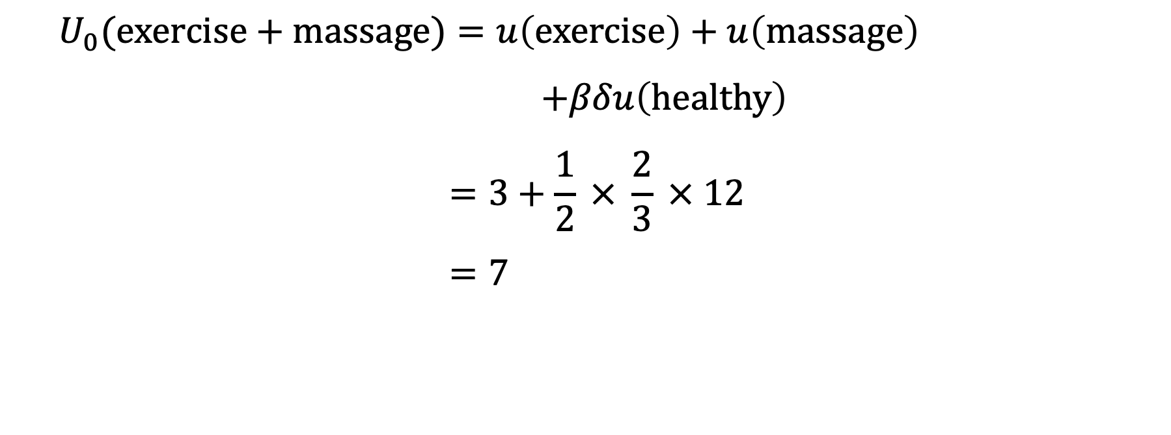
$$U_{0}(exercise+massage)=u\left(exercise\right)+u\left(massage\right)$$
$$+βδu\left(healthy\right)$$
$$=3+\frac{1}{2} × \frac{2}{3} × 12$$
$$=7$$

